Slide 1


Database Maintenance and Monitoring with Navicat
Navicat Certified Database Administrator - Associate

Slide 2

HKIIT - Navicat Certified Database Administrator - Associate
Learning Outline
Introduction to Database Maintenance
Understanding Fragmentation
Maintaining MySQL Tables with Navicat
Monitoring the MySQL Server with Navicat
Utilizing Search Features in Navicat

Slide 3

MAINTENANCE
Fragmentation
Fragmentation in MySQL InnoDB tables occurs during INSERT, UPDATE, and DELETE operations
Logical fragmentation
Physical fragmentation
HKIIT - Navicat Certified Database Administrator - Associate
Notes:
UPDATE: Updating a variable-length column can either create a hole if the new data is smaller, or trigger a page split (causing fragmentation) if the data is larger and doesn't fit in the existing space.

Slide 4
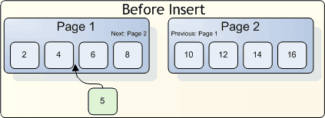
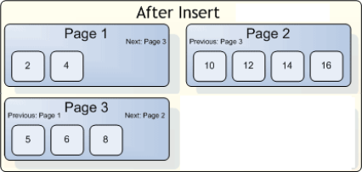
MAINTENANCE
Logical Fragmentation due to a Page Split
Consider two pages of a table ordered by a primary key (PK).
Both pages are full, with records in ascending PK order.
A new record with a primary key value of 5 needs to be inserted.
Since the page that should contain 5 is already full, InnoDB performs a page split.
It splits the page roughly in half, shifting some records to a newly allocated page and inserting the new record there.
HKIIT - Navicat Certified Database Administrator - Associate

Slide 5
MAINTENANCE
Fragmentation: During UPDATE operations
When updating a variable-length column (like VARCHAR), depending on the size of the new data, the operation can also introduce fragmentation:
If the new data is smaller than the old data, the remaining unused space becomes a hole in the page, creating internal fragmentation.
If the new data is larger than the old data, and there is insufficient space on the page, it may trigger a page split, similar to the INSERT scenario, causing both logical and physical fragmentation.
HKIIT - Navicat Certified Database Administrator - Associate
Notes:
UPDATE: Updating a variable-length column can either create a hole if the new data is smaller, or trigger a page split (causing fragmentation) if the data is larger and doesn't fit in the existing space.

Slide 6
MAINTENANCE
Fragmentation: During DELETE operations
When records are deleted from an InnoDB table, MySQL leaves behind empty space or holes in the pages where the deleted records were stored. These holes are not automatically reclaimed by the file system or the database engine, leading to fragmentation over time.
Over time, the number of gaps (holes) left behind by deleted rows can grow, and the space may not be efficiently reused by new inserts.
HKIIT - Navicat Certified Database Administrator - Associate
Notes:
Deleting records leaves holes in the page. These holes aren't reclaimed automatically, leading to internal fragmentation, which can slow down scans as MySQL reads up to the table's high-water mark.

Slide 7
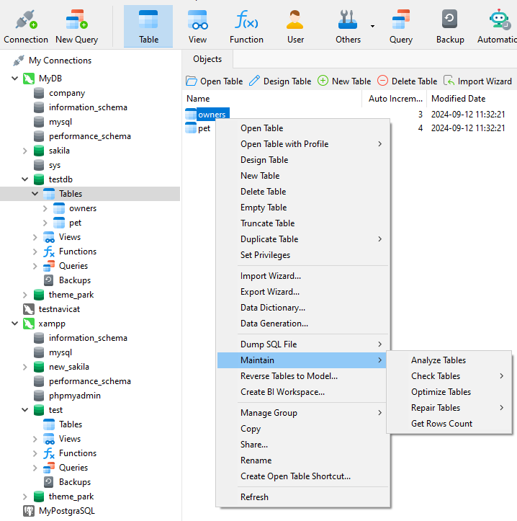
MAINTENANCE
Maintain MySQL Tables with Navicat
Navicat supports four major tasks, which can be performed on MySQL database tables:
Analysis
Check
Optimization
Repairs
HKIIT - Navicat Certified Database Administrator - Associate

Slide 8
TABLE STATISTICS
Analyzing a MySQL table or view with Navicat
MySQL uses the stored key distribution to decide in which order the tables should be joined.
The Analyze Table command analyzes and stores the key distribution for the selected table. Updates statistics about the distribution of data in a table, especially the key values (like primary keys and indexes).
These statistics help the MySQL query optimizer make better decisions when planning how to execute queries efficiently.
To query the index information of a table, you use the SHOW INDEXES statement as follows:
SHOW INDEX from your_table_name;
MySQL :: MySQL 8.4 Reference Manual :: 15.7.3.1 ANALYZE TABLE Statement
HKIIT - Navicat Certified Database Administrator - Associate

Slide 9
TABLE STATISTICS
Fields returned by SHOW INDEX:
Table: The name of the table where the index exists.
Non_unique:
0 if the index does not allow duplicate values (like a primary key).
1 if the index allows duplicates (like a regular non-unique index).
Key_name: The name of the index (e.g., the name of the primary key or any other named index).
Seq_in_index: The position of the column in the index. It starts at 1 for the first column.
Column_name: The name of the column included in the index.
Collation: How the column is sorted in the index:
'A' for Ascending order.
NULL if the column is not sorted.
HKIIT - Navicat Certified Database Administrator - Associate

Slide 10
TABLE STATISTICS
Fields returned by SHOW INDEX:
Cardinality: An estimate of the number of unique values in the index.
Higher cardinality means the index is more selective, which helps MySQL choose it for query optimization.
Cardinality is updated by running ANALYZE TABLE.
Sub_part: The number of indexed characters if the column is only partially indexed (used in text columns).NULL if the entire column is indexed.
Packed: Shows how the index key is packed (compressed).NULL if it is not packed.
Null:
YES if the indexed column can contain NULL values.
NO if the column does not allow NULLs.
HKIIT - Navicat Certified Database Administrator - Associate

Slide 11
TABLE STATISTICS
Fields returned by SHOW INDEX:
Index_type: The type of index, such as:
BTREE (most common for general indexing).
FULLTEXT (for full-text searches).
HASH (for fast lookups, typically for MEMORY tables).
RTREE (used for spatial data indexing).
Comment: Any additional remarks or comments about the index (often empty).
HKIIT - Navicat Certified Database Administrator - Associate

Slide 12
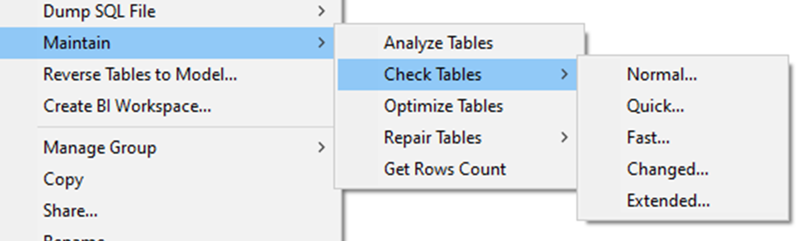
MAINTENANCE
Checking a table or view
This maintenance task checks a table for errors.
Additional options for checking are summarized in the table below:
Options | Functions
Quick | Does not scan the rows to check for incorrect links.
Fast | Checks only those tables that have not been closed properly.
Changed | Checks only those tables that have been changed since the last check or that have not been closed properly.
Extended | Does a full key lookup for all the keys for each row. This ensures that the table is 100 percent consistent, but takes a long time. It applies only to MylSAM tables and views.
HKIIT - Navicat Certified Database Administrator - Associate

Slide 13
MAINTENANCE
Optimize MySQL Tables with Navicat
It will cleans up a MylSAM table by defragmenting it.
This involves reclaiming unused space resulting from deletes & updates, coalescing split records and stored non-contiguously.
It sorts the index pages if they are out of order and updates the index statistics.
It also works for InnoDB, but maps to ALTER TABLE to rebuild the table.
This updates index statistics and frees space in the clustered index.
HKIIT - Navicat Certified Database Administrator - Associate

Slide 14
MAINTENANCE
Repair a marked as crashed table with Navicat
To repair a MyISAM table, You can use `REPAIR` function in Navicat if the table checking operation indicates that there is a corruption or that an upgrade is required.
To repair an InnoDB table, check its integrity with CHECK TABLE. If issues are found, use Navicat to dump the table to an SQL file for backup, then drop the table. Restore the table from the dump file, and verify its integrity again.
MySQL :: MySQL 8.4 Reference Manual :: 15.7.3.5 REPAIR TABLE Statement
HKIIT - Navicat Certified Database Administrator - Associate

Slide 15
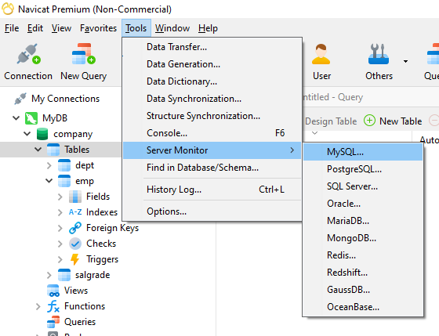
MONITORING
Monitoring the MySQL Server
With Navicat, you can monitor your database server(s) to view the running processes, the server's current status, as well as the properties of the databases, such as the variables. It is possible to get this information in real time for all of your servers, in a single, under-the-hood view
HKIIT - Navicat Certified Database Administrator - Associate

Slide 16
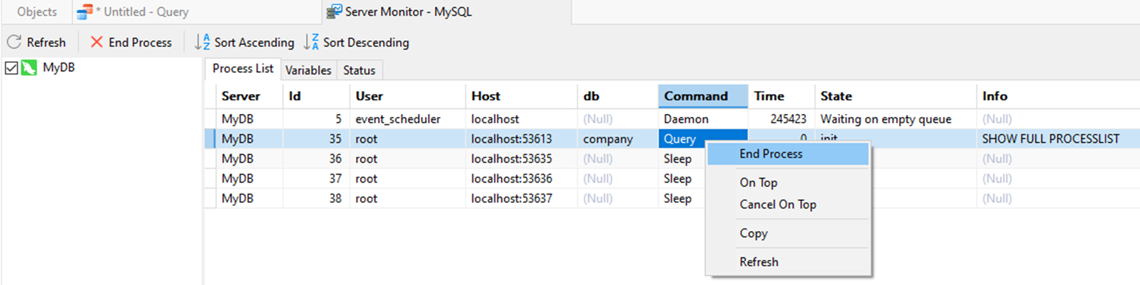
MONITORING
The Process List
The information you get on this screen can be listed as follows:
The server name that is defined in the connection settings
ID of the process running on the server
User who logged on to the server
Host or the IP from which the user is connected
The name of the database that is currently being used
Last Command that was issued by the userTime, State, and Info of the process
It is possible to forcibly end a process simply by clicking on it from the list to get it highlighted and hitting the End Process button.
HKIIT - Navicat Certified Database Administrator - Associate

Slide 17
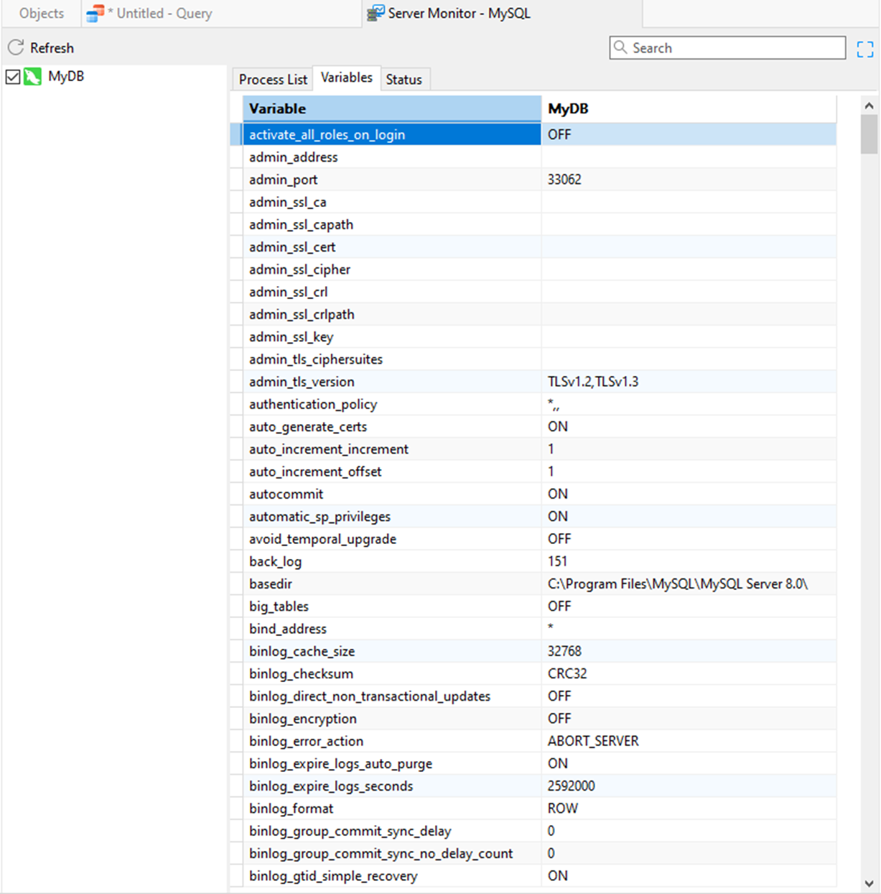
MONITORING
System variables
Listing all the server variables, such as character_set_server and date_f ormat, and the values set for these variables listed in alphabetical order.
Executing the SHOW VARIABLES command in the MySQL server console.
Possible to change the values.
HKIIT - Navicat Certified Database Administrator - Associate

Slide 18
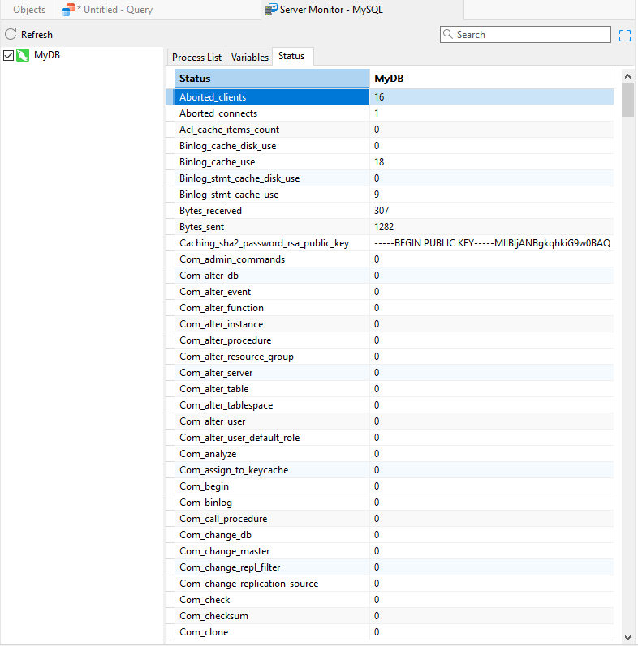
MONITORING
Server Status Information
The status tab lists the same standard information that would otherwise be retrieved from a MySQL server by issuing the SHOW STATUS command.
This outputs some long, read-only information understandable by advanced users and DBAs.
HKIIT - Navicat Certified Database Administrator - Associate

Slide 19
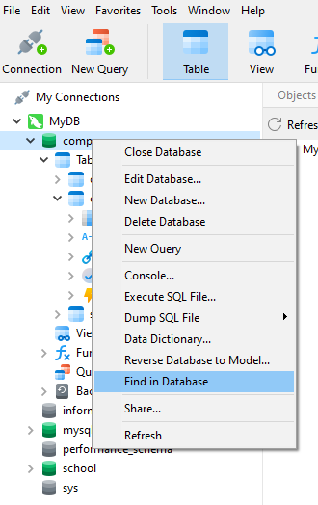
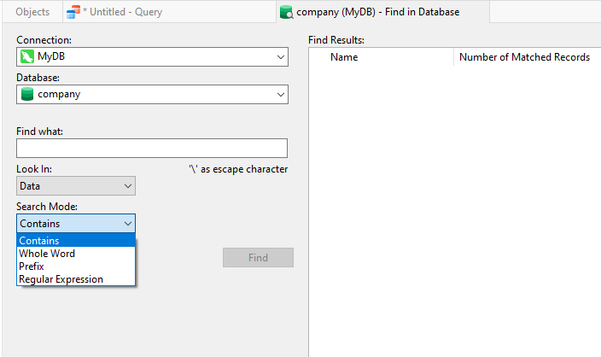
SEARCH
Revealing a hidden search feature of Navicat
You can use Navicat to locate one or more database table records matching a certain criteria.
Enter a search string and matching criteria (such as Exact or Contains, or even evaluate a Regular Expression).
HKIIT - Navicat Certified Database Administrator - Associate

Slide 20
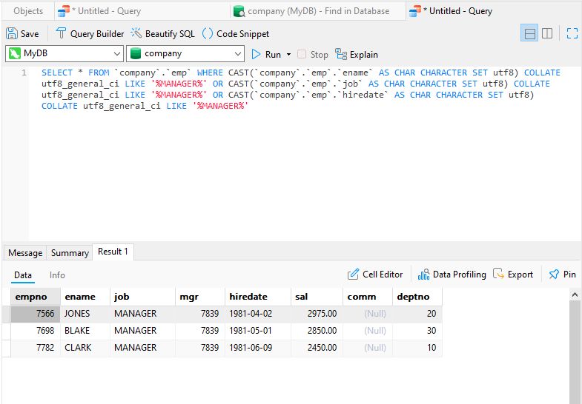
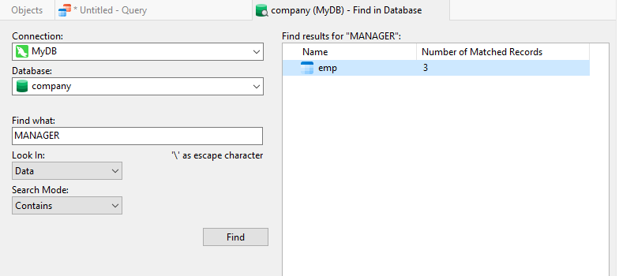
SEARCH
Revealing a hidden search feature of Navicat
when you double-click on one of the results, a new query window will open up with a generated SQL query that was translated from our search criteria, which is automatically executed once, with the results displayed below it.
HKIIT - Navicat Certified Database Administrator - Associate

Slide 21

Navicat
Database Maintenance and Monitoring
In this lesson, we discussed the causes and effects of fragmentation in MySQL databases and maintain database tables using Navicat tools. We have learned to monitor MySQL server in real time and leverage Navicat's search functionality to locate specific records efficiently.
HKIIT - Navicat Certified Database Administrator - Associate

